Slide 1

“Car Price Prediction Using ML”

Slide 2
Introduction
We are about to deploy an ML model for car selling price prediction and analysis. This kind of system becomes handy for many people.
Imagine a situation where you have an old car and want to sell it. You may of course approach an agent for this and find the market price, but later may have to pay pocket money for his service in selling your car. But what if you can know your car selling price without the intervention of an agent. Or if you are an agent, definitely this will make your work easier. Yes, this system has already learned about previous selling prices over years of various cars.
So, to be clear, this deployed web application will provide you will the approximate selling price for your car based on the fuel type, years of service, showroom price, the number of previous owners, kilometres driven, if dealer/individual, and finally if the transmission type is manual/automatic. And that’s a brownie point.

Slide 3
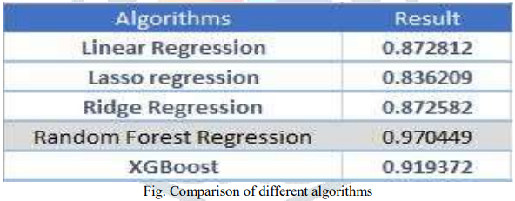
USED ALGORITHM

Slide 4
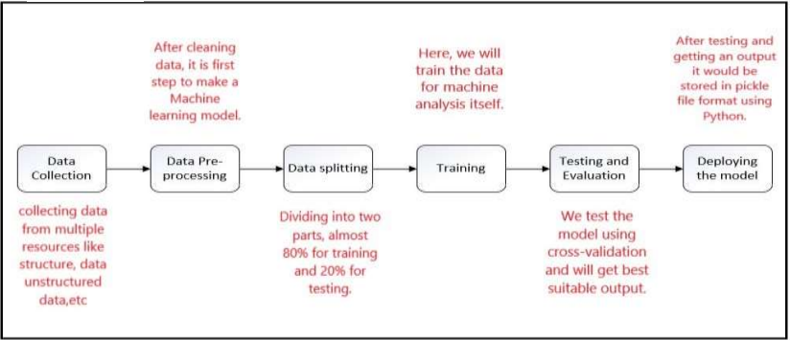
METHODOLOGY

Slide 5
Used in many Websites:-
Quikerindia.com
Cars24.com
Mahindra Company
CarWale.com
And Many More……….

Slide 6
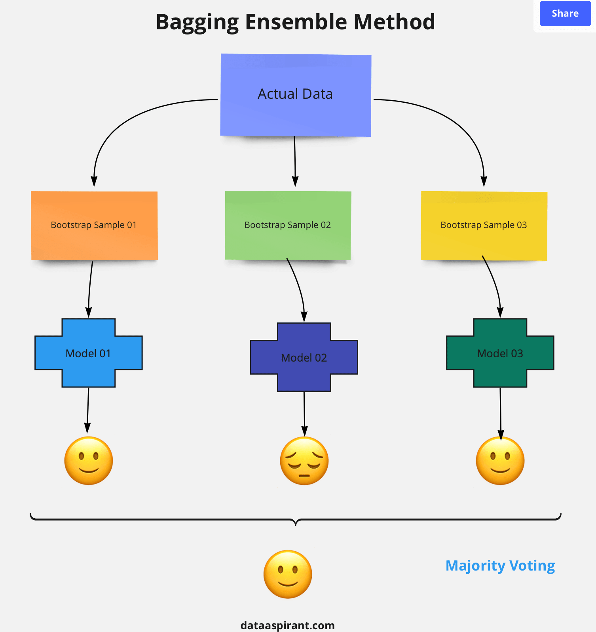
Random Forest Regression:-

Slide 7
Link’s
Git-hub Link:-https://github.com/dhananjay2312/car_price_prediction
Deployment Link:-https://predicting-car-price.herokuapp.com

Slide 8
Conclusion
The model which we were making is to predict a value of second hand car using machine learning techniques. We have collected the data of cars from Kaggle having attributes like different cars and their year, kms driven, fuel type, transmission, etc. The data is then processed using different algorithms where results of each algorithms is compared, getting Random Forest algorithm as the most accurate amongst them, so we have used Random Forest because irrespective of size it runs efficiently and gives more accuracy than any other algorithm. Further it would be available in GUI as a Web-application developed using Pythonflask making it user friendly so that users could give input and get the price of a car according to it.

Slide 9
Thank you

